Slide 1
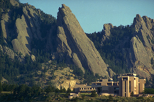
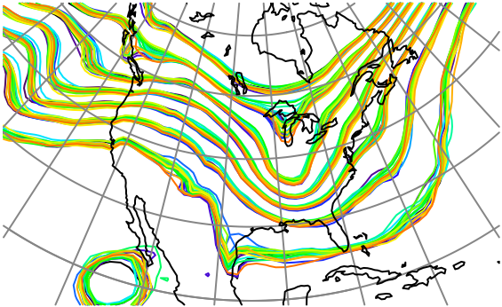
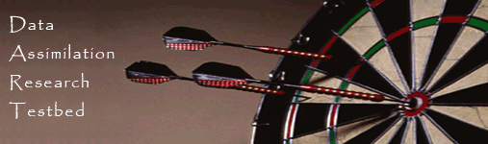
Non-Gaussian, Nonlinear Extensions for Ensemble Filter Data Assimilation with a Marginal Correction Rank Histogram Filter
Jeff Anderson, NCAR Data Assimilation Research Section

Slide 2
Bayes’ Rule
Outline
Many ensemble assimilation methods are Gaussian & linear.
Tracer applications are neither.
Describe methods to deal with this.
Notes:
s01f01.eps

Slide 3
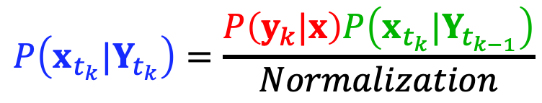
Bayes’ Rule
Bayes Rule (1D example)
Bayes rule is the key to ensemble data assimilation.
$$P\left(x_{t_{k}}|Y_{t_{k}}\right)=\frac{P\left(y_{k}|x\right)P\left(x_{t_{k}}|Y_{t_{k−1}}\right)}{Normalization}$$
Temperature (for example)
Notes:
s01f01.eps

Slide 4
Bayes’ Rule
Bayes Rule (1D example)
Prior: from
model forecast.
$$P\left(x_{t_{k}}|Y_{t_{k}}\right)=\frac{P\left(y_{k}|x\right)P\left(x_{t_{k}}|Y_{t_{k−1}}\right)}{Normalization}$$
Temperature (for example)
Notes:
s01f01.eps

Slide 5
Bayes Rule (1D example)
Likelihood:
from instrument.
$$P\left(x_{t_{k}}|Y_{t_{k}}\right)=\frac{P\left(y_{k}|x\right)P\left(x_{t_{k}}|Y_{t_{k−1}}\right)}{Normalization}$$
Temperature (for example)

Slide 6
Bayes Rule (1D example)
$$P\left(x_{t_{k}}|Y_{t_{k}}\right)=\frac{P\left(y_{k}|x\right)P\left(x_{t_{k}}|Y_{t_{k−1}}\right)}{Normalization}$$
Temperature (for example)

Slide 7
Bayes Rule (1D example)
$$P\left(x_{t_{k}}|Y_{t_{k}}\right)=\frac{P\left(y_{k}|x\right)P\left(x_{t_{k}}|Y_{t_{k−1}}\right)}{Normalization}$$
Temperature (for example)

Slide 8
Bayes Rule (1D example)
Posterior: (analysis).
$$P\left(x_{t_{k}}|Y_{t_{k}}\right)=\frac{P\left(y_{k}|x\right)P\left(x_{t_{k}}|Y_{t_{k−1}}\right)}{Normalization}$$
Temperature (for example)

Slide 9
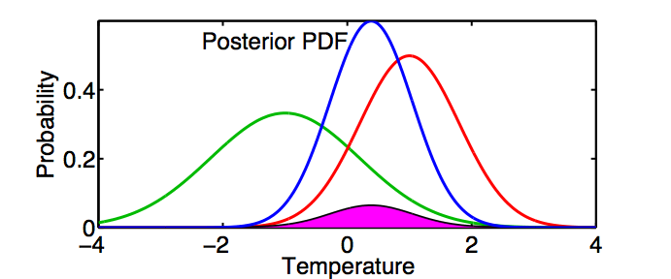
Bayes Rule (1D example)
Most ensemble assimilation algorithms assume Gaussians.
May be okay for quantity like temperature.
$$P\left(x_{t_{k}}|Y_{t_{k}}\right)=\frac{P\left(y_{k}|x\right)P\left(x_{t_{k}}|Y_{t_{k−1}}\right)}{Normalization}$$

Slide 10
Bayes Rule (1D example)
Most ensemble assimilation algorithms assume Gaussians.
Tracer concentration is bounded. Gaussian a poor choice.
$$P\left(x_{t_{k}}|Y_{t_{k}}\right)=\frac{P\left(y_{k}|x\right)P\left(x_{t_{k}}|Y_{t_{k−1}}\right)}{Normalization}$$

Slide 11
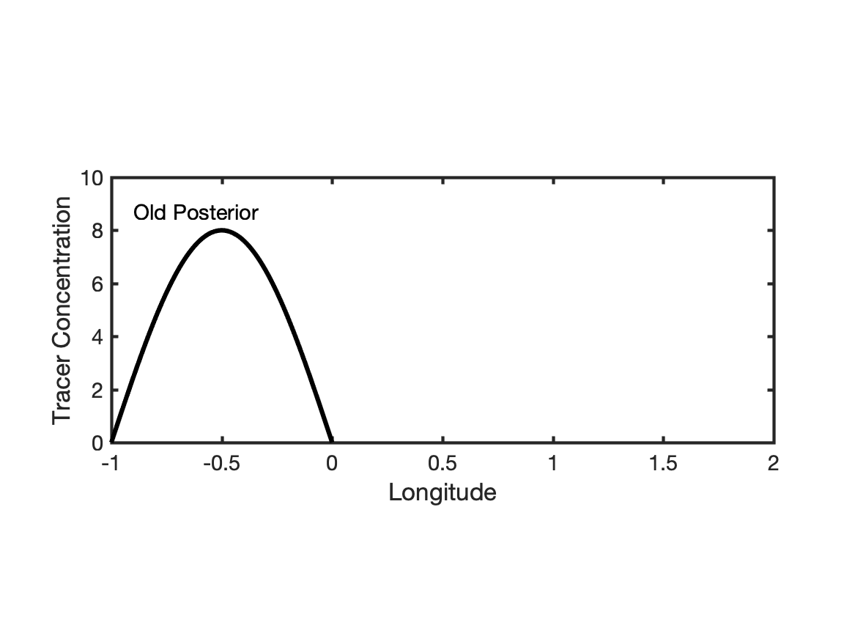
Advection of Tracer -> Nonlinear Prior for Concentration & Wind

Slide 12
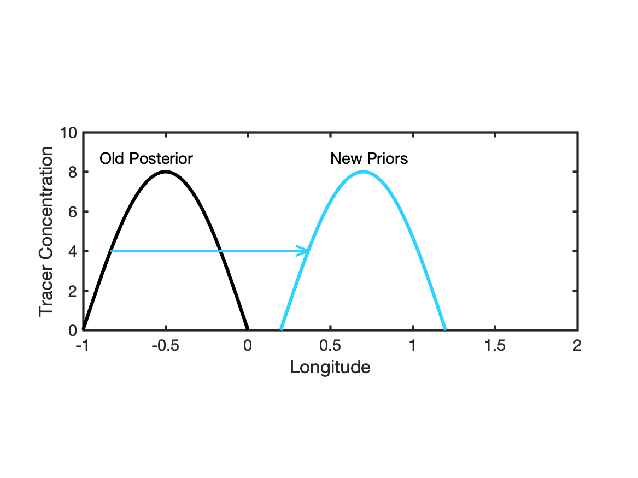
Advection of Tracer -> Nonlinear Prior for Concentration & Wind
Tracer advected by uncertain winds.

Slide 13
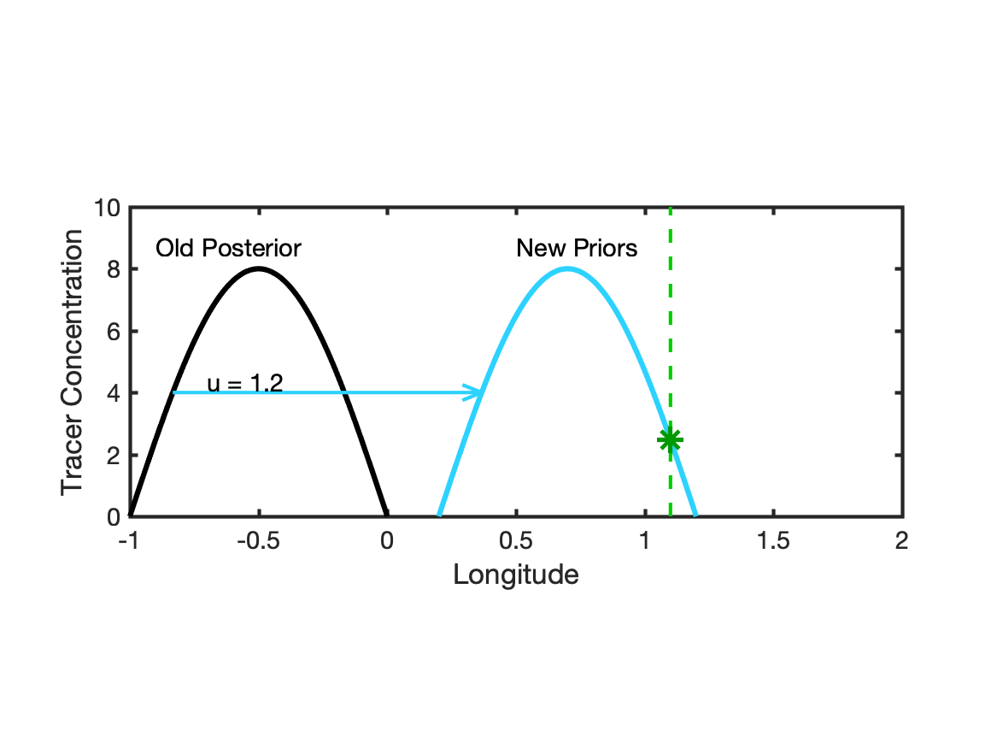
Advection of Tracer -> Nonlinear Prior for Concentration & Wind
Tracer advected by uncertain winds.
Concentration Observed at Longitude 1.1

Slide 14
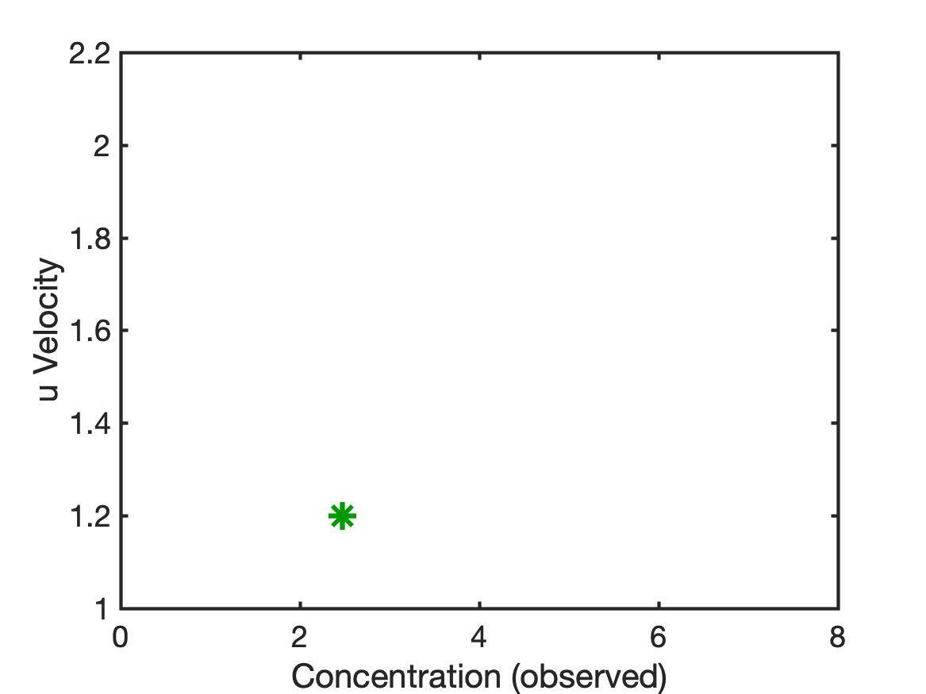
Advection of Tracer -> Nonlinear Prior for Concentration & Wind
Tracer advected by uncertain winds.
Concentration Observed at Longitude 1.1
Bivariate Prior shows how
Concentration Observation
Impacts Wind.

Slide 15
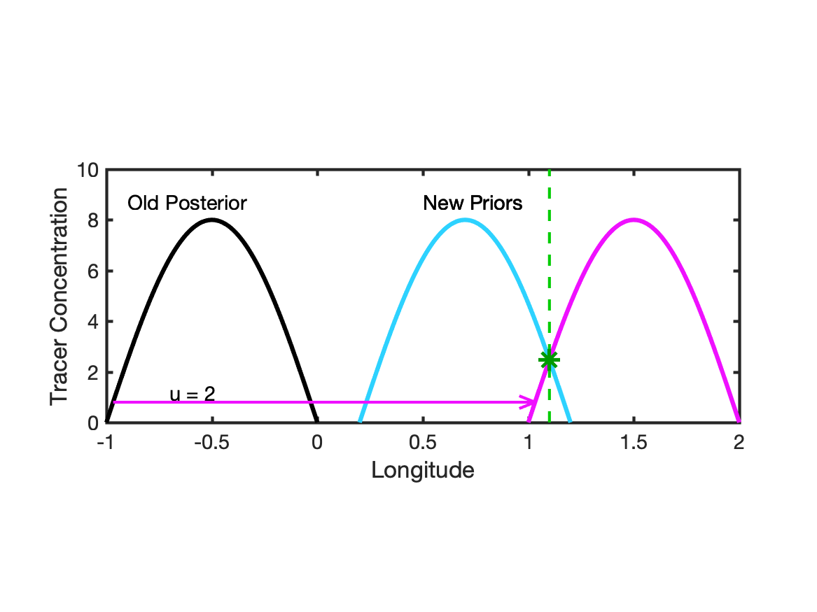
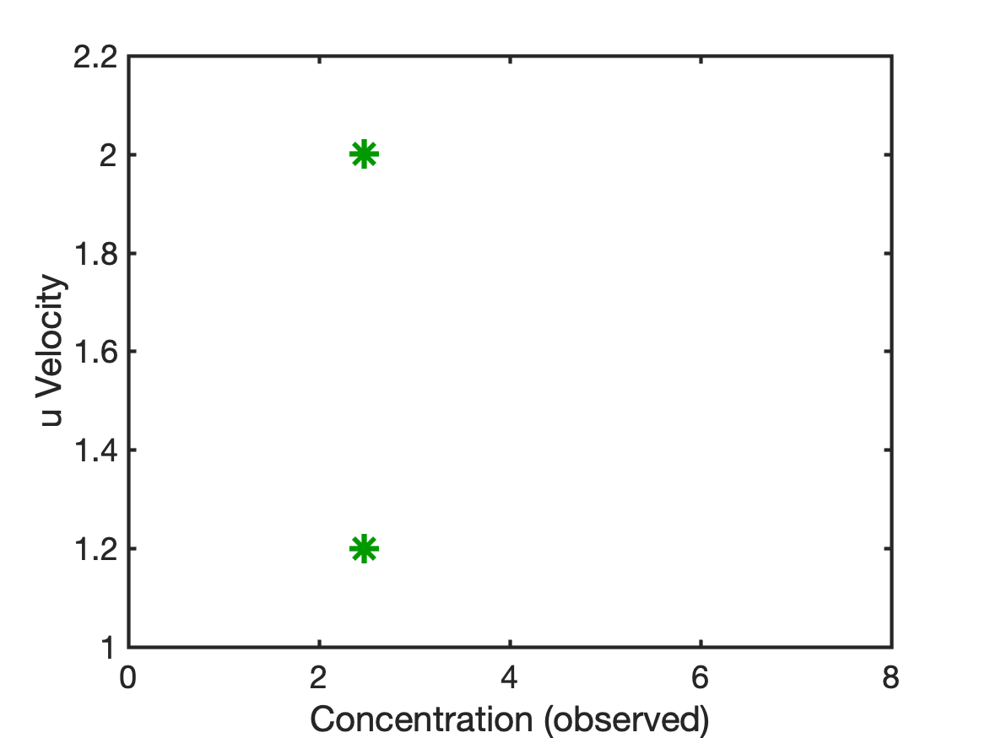
Advection of Tracer -> Nonlinear Prior for Concentration & Wind
Tracer advected by uncertain winds.
Concentration Observed at Longitude 1.1
Bivariate Prior shows how
Concentration Observation
Impacts Wind.

Slide 16
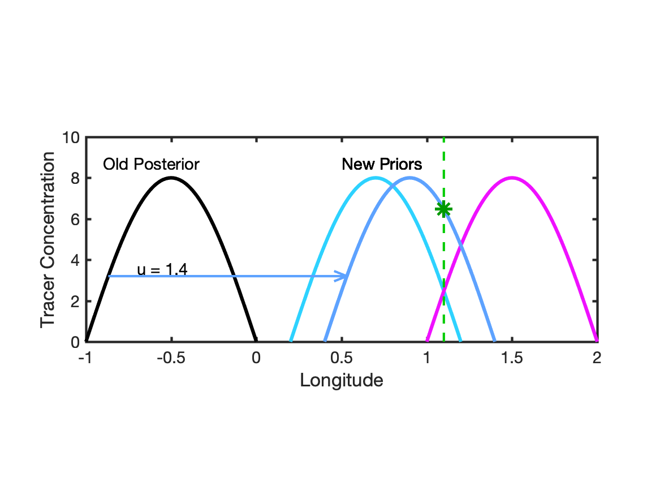
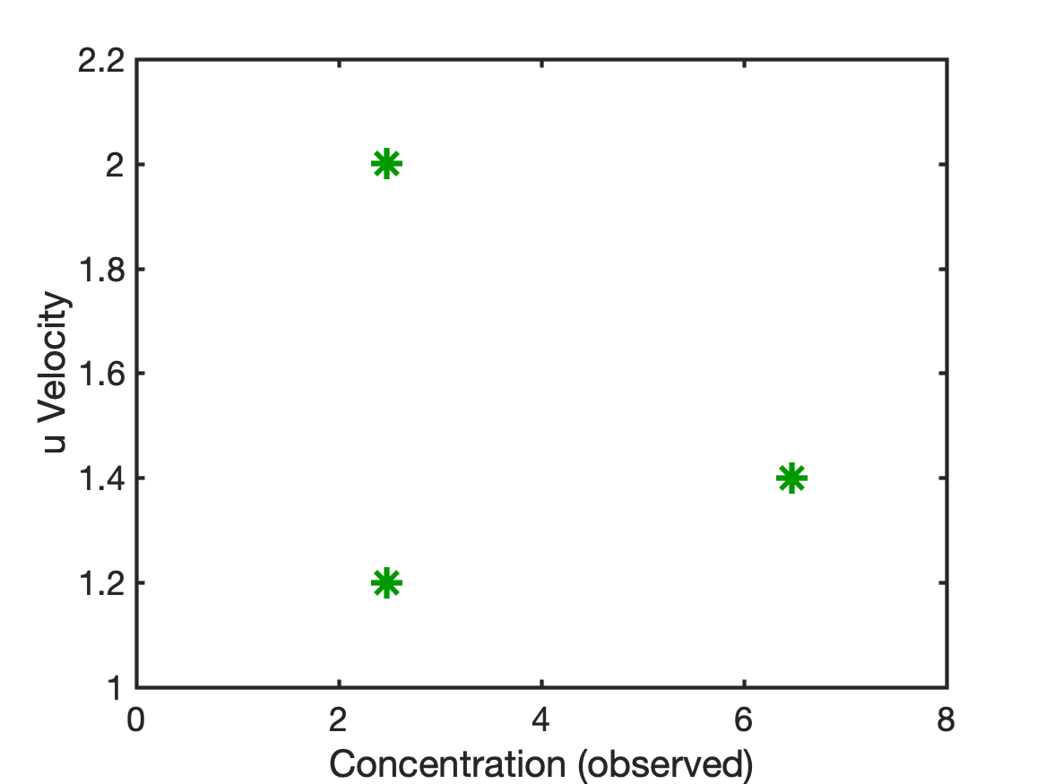
Advection of Tracer -> Nonlinear Prior for Concentration & Wind
Tracer advected by uncertain winds.
Concentration Observed at Longitude 1.1
Bivariate Prior shows how
Concentration Observation
Impacts Wind.

Slide 17
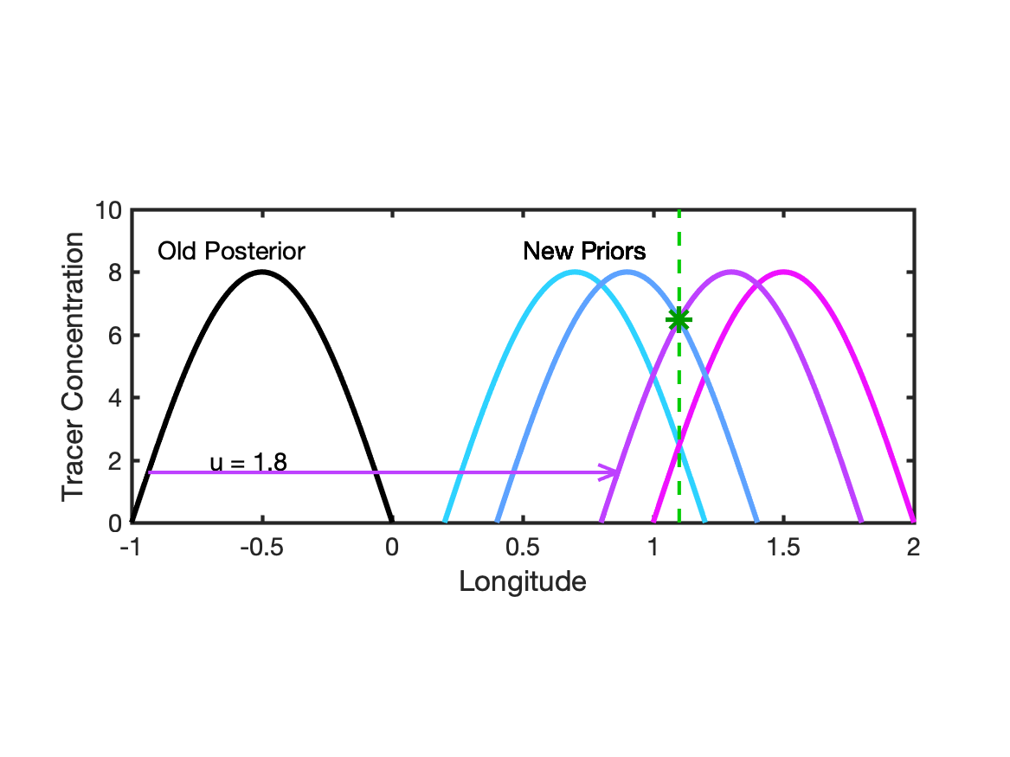
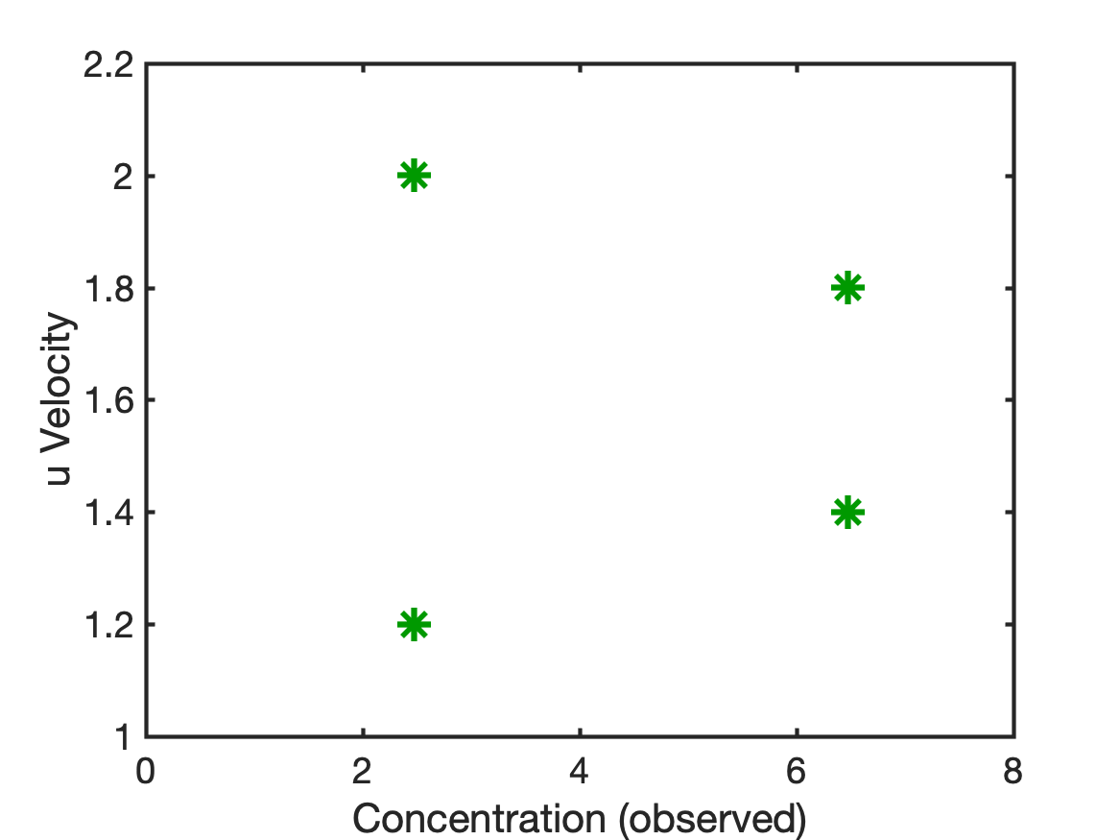
Advection of Tracer -> Nonlinear Prior for Concentration & Wind
Tracer advected by uncertain winds.
Concentration Observed at Longitude 1.1
Bivariate Prior shows how
Concentration Observation
Impacts Wind.

Slide 18
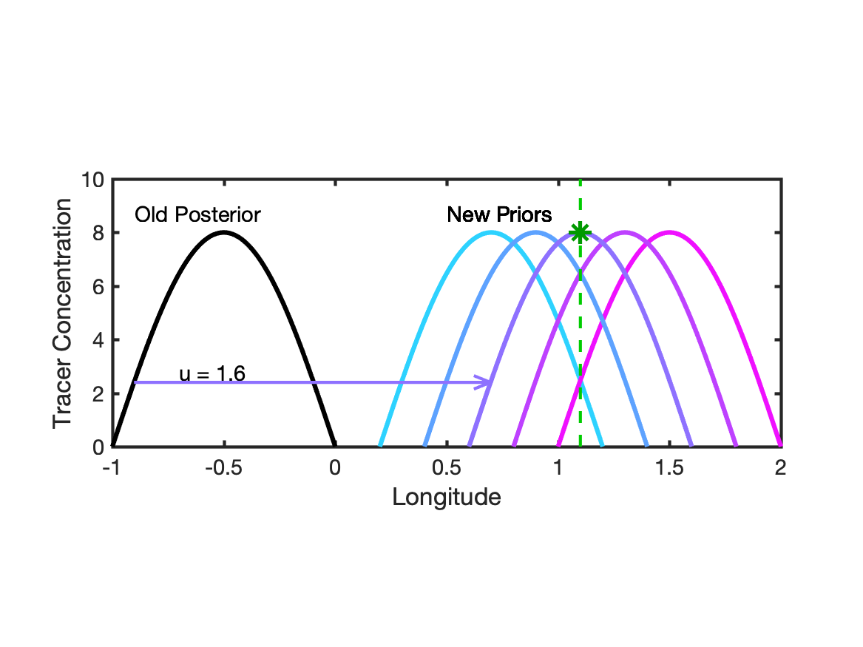
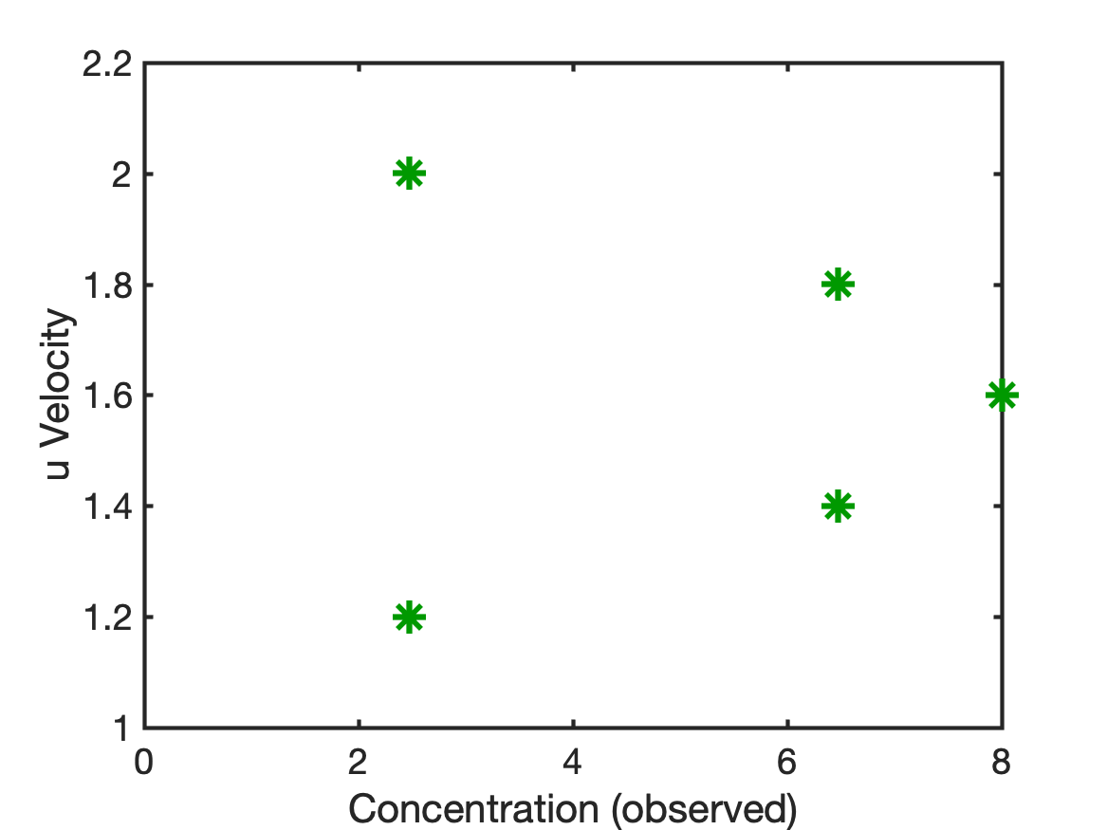
Advection of Tracer -> Nonlinear Prior for Concentration & Wind
Tracer advected by uncertain winds.
Concentration Observed at Longitude 1.1
Bivariate Prior shows how
Concentration Observation
Impacts Wind.

Slide 19
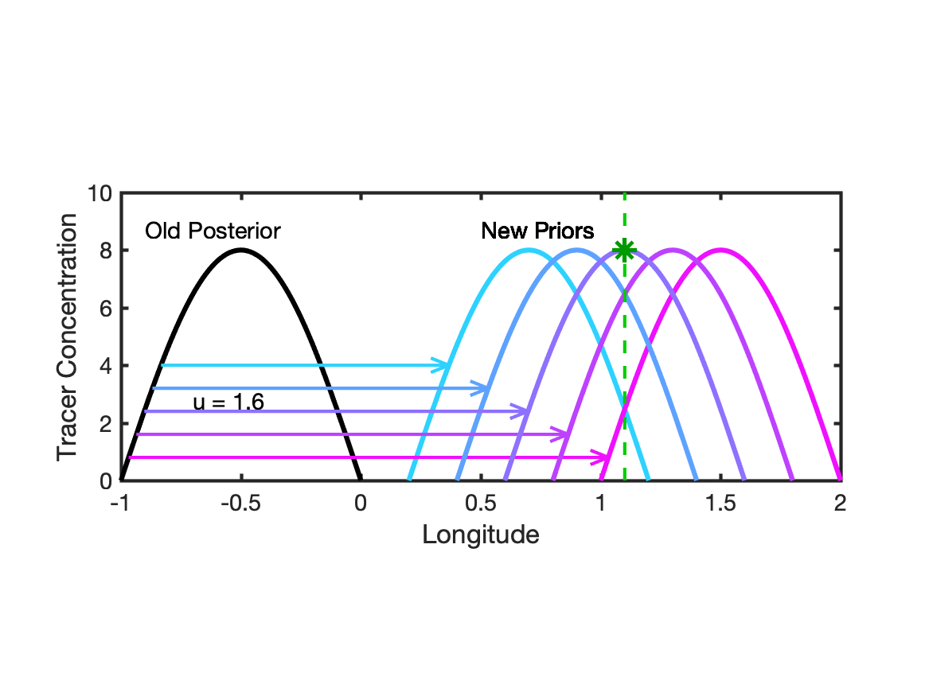
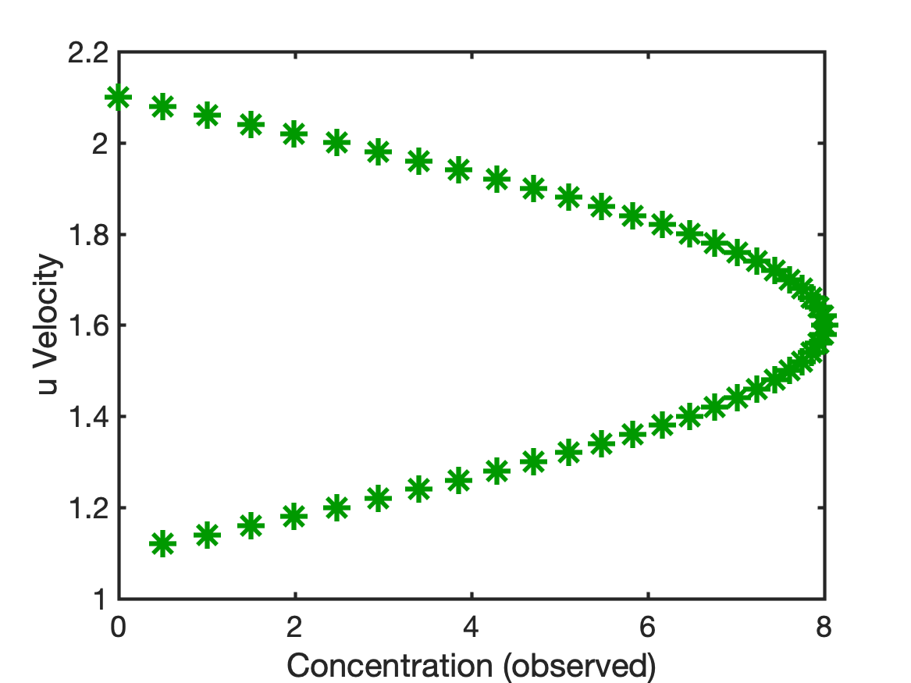
Advection of Tracer -> Nonlinear Prior for Concentration & Wind
Tracer advected by uncertain winds.
Concentration Observed at Longitude 1.1
Bivariate Prior shows how
Concentration Observation
Impacts Wind.

Slide 20
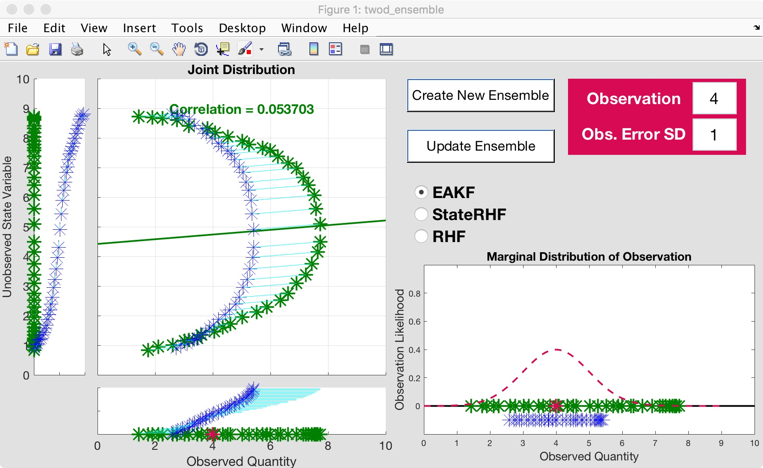
Advection of Cosine Tracer: EAKF
Try to exploit nonlinear prior relation between a state variable and an observation.
Example: Observation y~log(x).
Also relevant for variables that are log transformed for boundedness (like concentrations).
MCRHF

Slide 21
Challenges for Tracer Assimilation
Non-Gaussian bounded priors.
Nonlinear bivariate priors.
Solution: More general representation of priors and likelihoods.
Rank Histogram Filters for State Variables.

Slide 22
Marginal Correction Rank Histogram (MCRHF)
Have a prior ensemble for a state variable (like wind).

Slide 23
Marginal Correction Rank Histogram (MCRHF)
1/6 of probability.
Step 1: Get continuous prior distribution density.
Place (ens_size + 1)⁻¹ mass between adjacent ensemble members.
Reminiscent of rank histogram evaluation method.

Slide 24
Marginal Correction Rank Histogram (MCRHF)
1/6 of probability.
Step 1: Get continuous prior distribution density.
Place (ens_size + 1)⁻¹ mass between adjacent ensemble members.
Reminiscent of rank histogram evaluation method.

Slide 25
Marginal Correction Rank Histogram (MCRHF)
1/6 of probability.
Step 1: Get continuous prior distribution density.
Place (ens_size + 1)⁻¹ mass between adjacent ensemble members.
Reminiscent of rank histogram evaluation method.

Slide 26
Marginal Correction Rank Histogram (MCRHF)
1/6 of probability.
Step 1: Get continuous prior distribution density.
Place (ens_size + 1)⁻¹ mass between adjacent ensemble members.
Reminiscent of rank histogram evaluation method.

Slide 27
Marginal Correction Rank Histogram (MCRHF)
1/6 of probability.
1/6 of probability.
Step 1: Get continuous prior distribution density.
Partial gaussian kernels on tails, N(tail_mean, ens_sd).
tail_mean selected so that (ens_size + 1)⁻¹ mass is in tail.

Slide 28
Marginal Correction Rank Histogram (MCRHF)
Step 2: Get observation likelihood for each ensemble member.

Slide 29
Marginal Correction Rank Histogram (MCRHF)
Step 3: Approximate likelihood with trapezoidal quadrature.
Use long flat tails.

Slide 30
Marginal Correction Rank Histogram (MCRHF)
Step 4: Compute continuous posterior distribution.
Just Bayes, multiply prior by likelihood and normalize.
Really simple with uniform likelihood tails.

Slide 31
Marginal Correction Rank Histogram (MCRHF)
Step 5: Compute updated ensemble members:
(ens_size +1)⁻¹ of posterior mass between each ensemble pair.
(ens_size +1)⁻¹ in each tail.

Slide 32
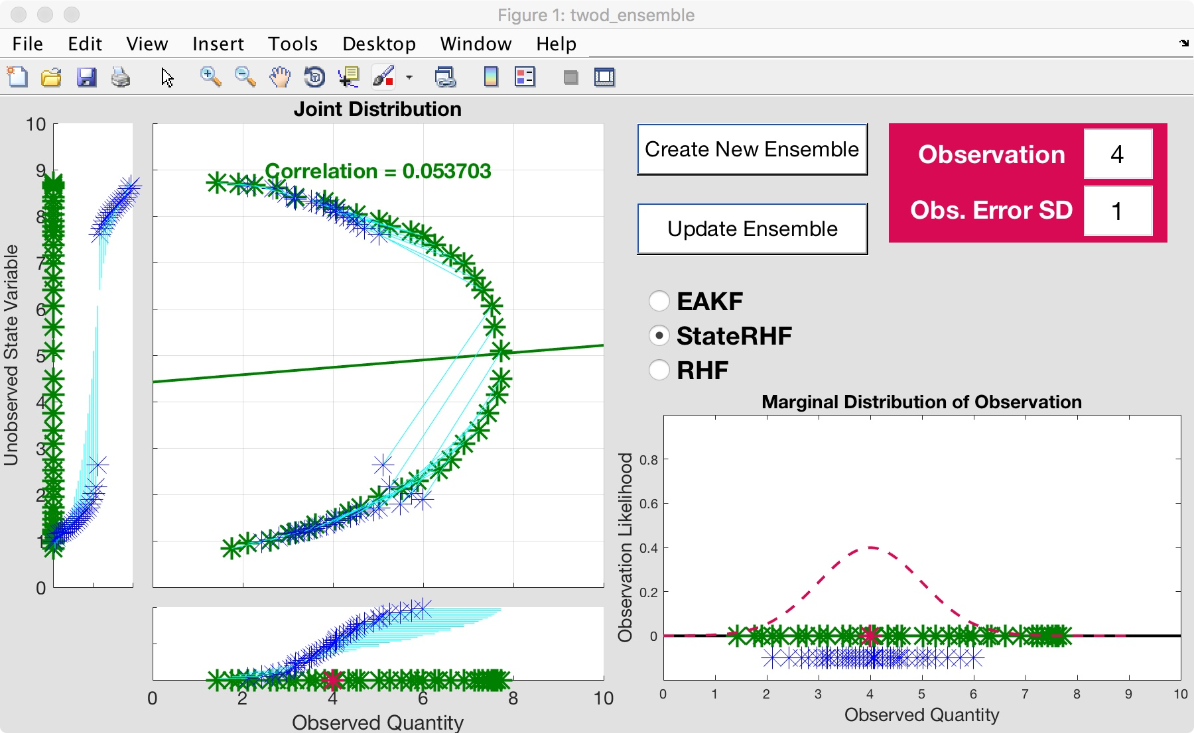
Advection of Cosine Tracer: MCRHF
Try to exploit nonlinear prior relation between a state variable and an observation.
Example: Observation y~log(x).
Also relevant for variables that are log transformed for boundedness (like concentrations).
MCRHF

Slide 33
Details for Marginal Correction RHF method (MCRHF)
Do observation RHF with regression for preliminary posterior.
Get RHF State Marginal.
Rank statistics of posterior same as preliminary posterior.
Ensemble member with smallest preliminary posterior value gets smallest posterior value from RHF State Marginal.
Works well for many applications (but more expensive).

Slide 34
MCRHF Capabilities
Enforce additional prior constraints, like boundedness.
Use arbitrary likelihoods.
Notes:
Slide 7: GPS occultation forward operators
Non-local refractivity : (Sokolovskiy et al., MWR 133, 2200-2212)
NEED DETAILS OF ALGORITHM step size???
upper limits
grid pictures for different latitudes
Three pictures exist: ~jla/talks_and_meetings/2009/ams/cam_gps_talk/gps_lat*
Expect minor differences with coarse grid, larger near poles

Slide 35
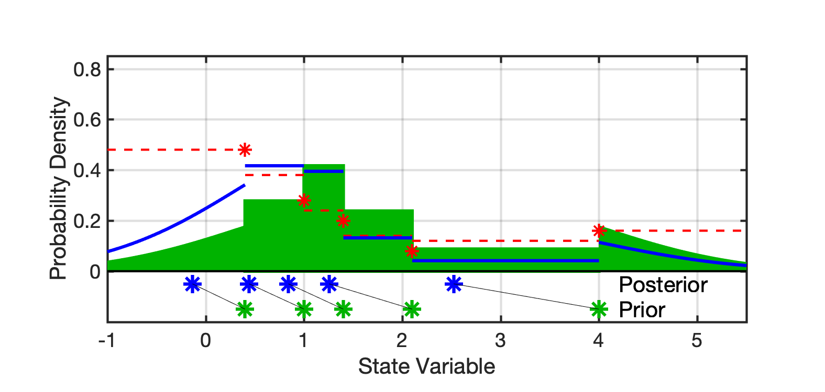
MCRHF with Bounded Prior
Standard MCRHF State Marginal.
Notes:
Slide 7: GPS occultation forward operators
Non-local refractivity : (Sokolovskiy et al., MWR 133, 2200-2212)
NEED DETAILS OF ALGORITHM step size???
upper limits
grid pictures for different latitudes
Three pictures exist: ~jla/talks_and_meetings/2009/ams/cam_gps_talk/gps_lat*
Expect minor differences with coarse grid, larger near poles

Slide 36
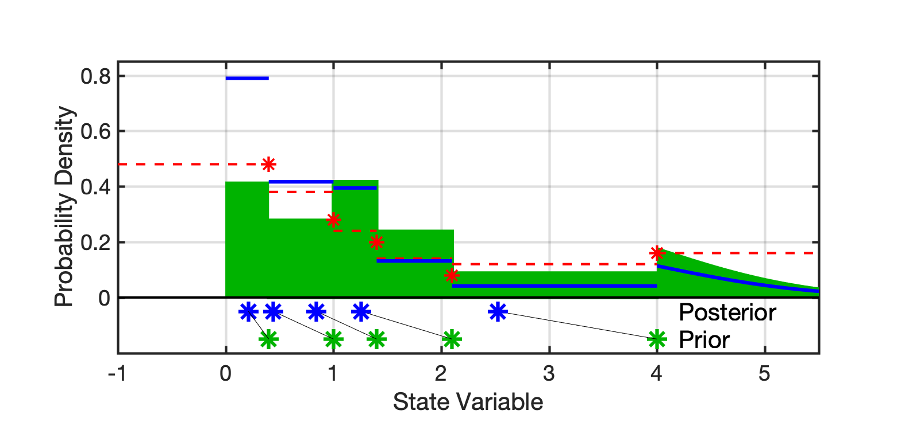
MCRHF with Bounded Prior
Bounded State Marginal, same ensemble but positive prior.
1/6 of probability
Notes:
Slide 7: GPS occultation forward operators
Non-local refractivity : (Sokolovskiy et al., MWR 133, 2200-2212)
NEED DETAILS OF ALGORITHM step size???
upper limits
grid pictures for different latitudes
Three pictures exist: ~jla/talks_and_meetings/2009/ams/cam_gps_talk/gps_lat*
Expect minor differences with coarse grid, larger near poles

Slide 37
Bounded State, Non-Gaussian Likelihoods
Bivariate example.
Log of prior is bivariate Gaussian, so prior is non-negative.
One variable observed.
Likelihood is Gamma.
Shape parameter is same as first prior ensemble.
Scale parameter is 1.
Assimilate single observation for many random priors.
Notes:
Slide 7: GPS occultation forward operators
Non-local refractivity : (Sokolovskiy et al., MWR 133, 2200-2212)
NEED DETAILS OF ALGORITHM step size???
upper limits
grid pictures for different latitudes
Three pictures exist: ~jla/talks_and_meetings/2009/ams/cam_gps_talk/gps_lat*
Expect minor differences with coarse grid, larger near poles

Slide 38
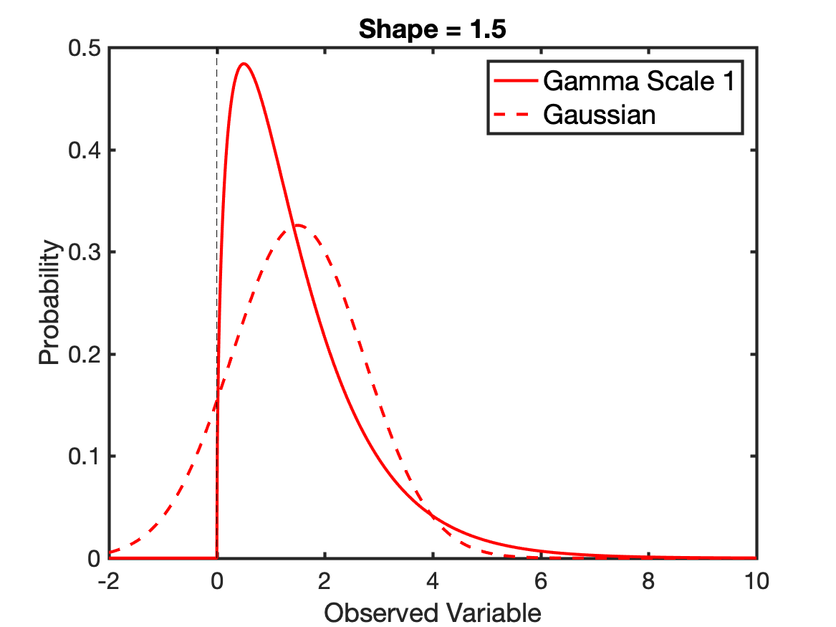
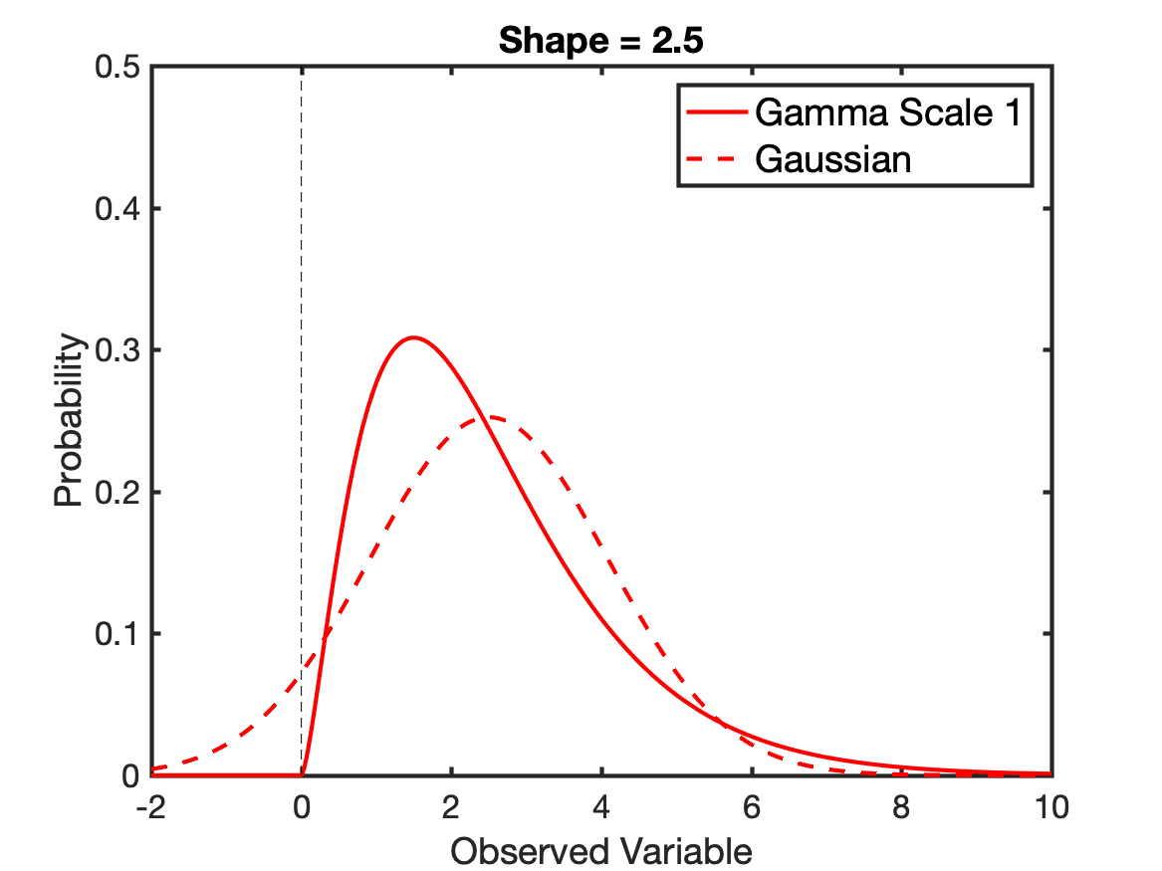
Bounded State, Non-Gaussian Likelihoods
Compare Gamma likelihood to Gaussian approximation.
Notes:
Slide 7: GPS occultation forward operators
Non-local refractivity : (Sokolovskiy et al., MWR 133, 2200-2212)
NEED DETAILS OF ALGORITHM step size???
upper limits
grid pictures for different latitudes
Three pictures exist: ~jla/talks_and_meetings/2009/ams/cam_gps_talk/gps_lat*
Expect minor differences with coarse grid, larger near poles

Slide 39
Bounded State, Non-Gaussian Likelihoods
Compare 3 Methods, 4 Ensemble sizes
Observed Var. Unobserved Var. Likelihood
EAKF Regression Gaussian
RHF MCRHF Gaussian
RHF MCRHF Gamma
Notes:
Slide 7: GPS occultation forward operators
Non-local refractivity : (Sokolovskiy et al., MWR 133, 2200-2212)
NEED DETAILS OF ALGORITHM step size???
upper limits
grid pictures for different latitudes
Three pictures exist: ~jla/talks_and_meetings/2009/ams/cam_gps_talk/gps_lat*
Expect minor differences with coarse grid, larger near poles

Slide 40
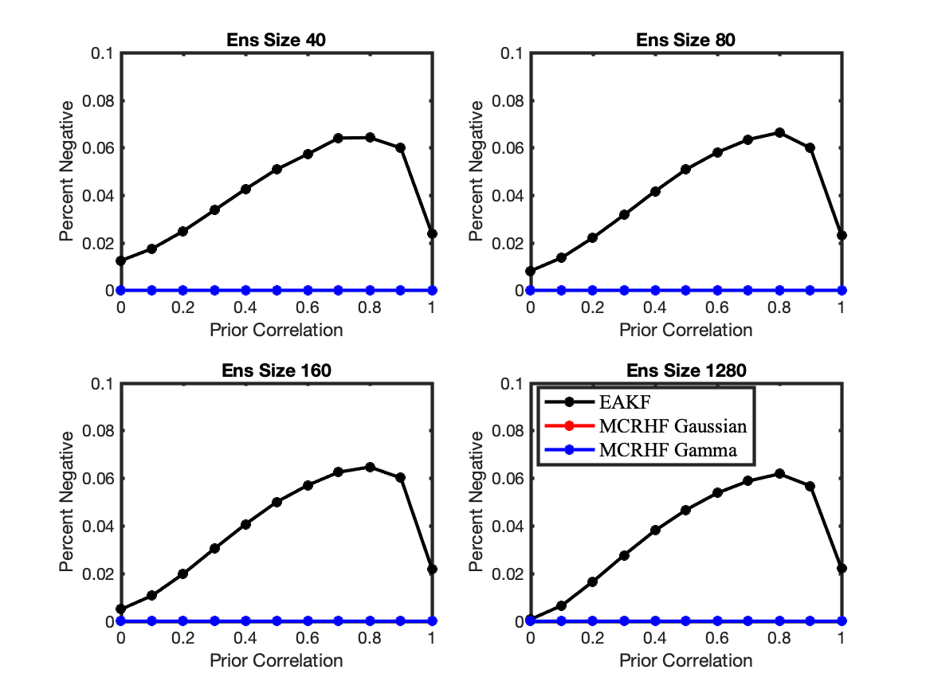
Percent Negative Posterior Members
Notes:
Slide 7: GPS occultation forward operators
Non-local refractivity : (Sokolovskiy et al., MWR 133, 2200-2212)
NEED DETAILS OF ALGORITHM step size???
upper limits
grid pictures for different latitudes
Three pictures exist: ~jla/talks_and_meetings/2009/ams/cam_gps_talk/gps_lat*
Expect minor differences with coarse grid, larger near poles

Slide 41
Percent Negative Posterior Members
MCRHF both (red and blue) have 0 by design.
Notes:
Slide 7: GPS occultation forward operators
Non-local refractivity : (Sokolovskiy et al., MWR 133, 2200-2212)
NEED DETAILS OF ALGORITHM step size???
upper limits
grid pictures for different latitudes
Three pictures exist: ~jla/talks_and_meetings/2009/ams/cam_gps_talk/gps_lat*
Expect minor differences with coarse grid, larger near poles

Slide 42
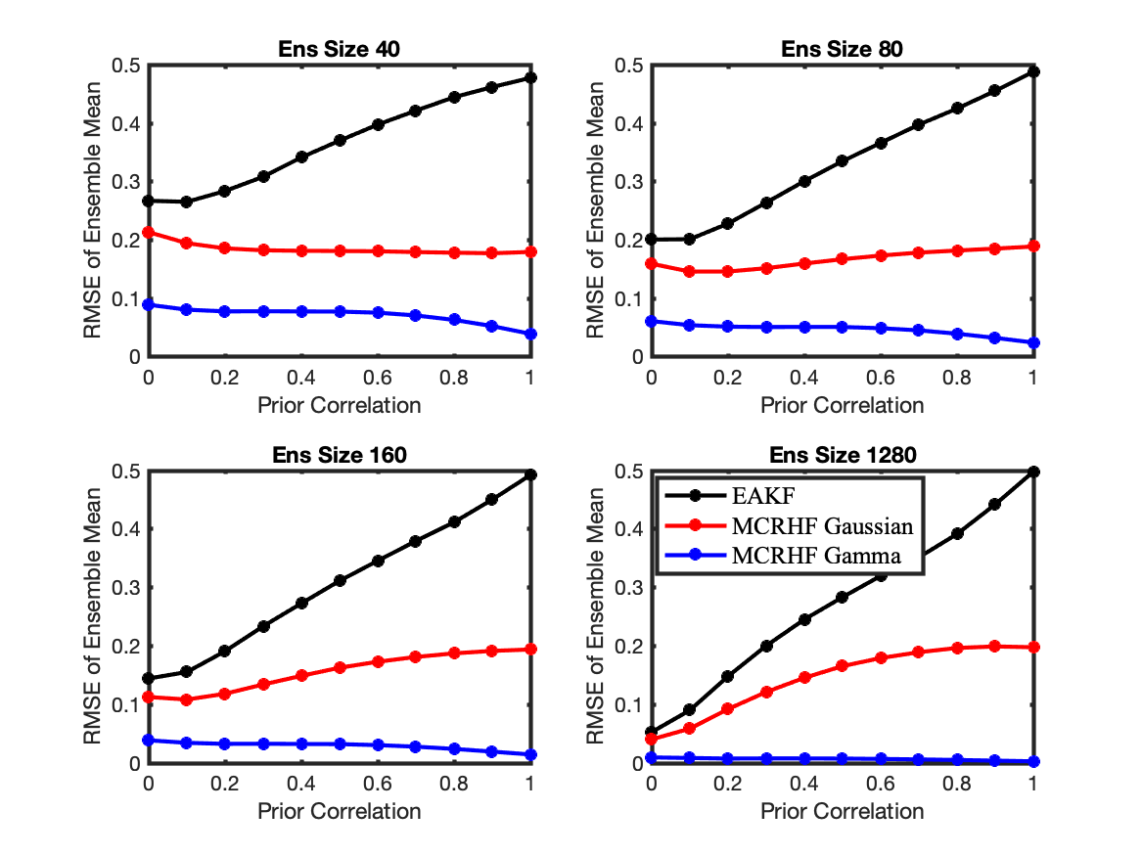
RMSE of Posterior Ensemble Mean
Notes:
Slide 7: GPS occultation forward operators
Non-local refractivity : (Sokolovskiy et al., MWR 133, 2200-2212)
NEED DETAILS OF ALGORITHM step size???
upper limits
grid pictures for different latitudes
Three pictures exist: ~jla/talks_and_meetings/2009/ams/cam_gps_talk/gps_lat*
Expect minor differences with coarse grid, larger near poles

Slide 43
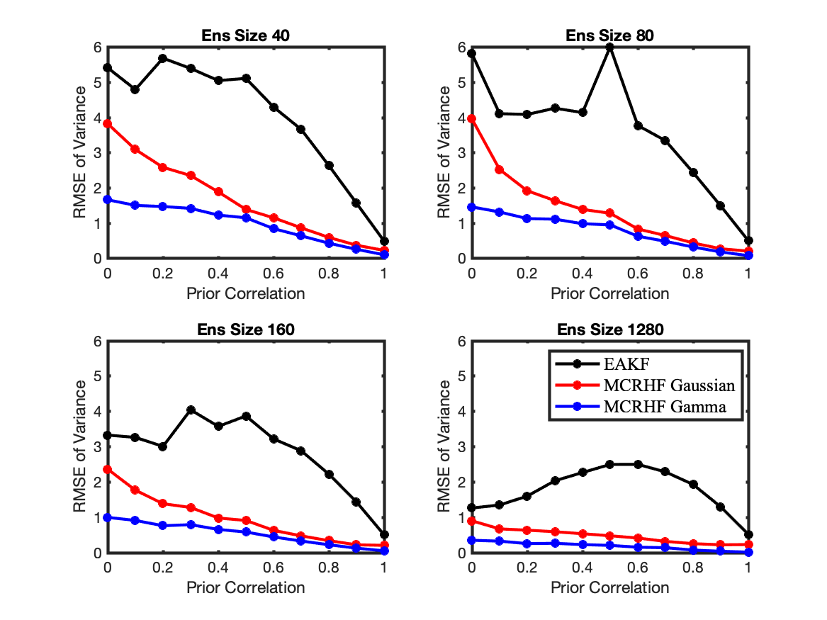
RMSE of Posterior Variance
Notes:
Slide 7: GPS occultation forward operators
Non-local refractivity : (Sokolovskiy et al., MWR 133, 2200-2212)
NEED DETAILS OF ALGORITHM step size???
upper limits
grid pictures for different latitudes
Three pictures exist: ~jla/talks_and_meetings/2009/ams/cam_gps_talk/gps_lat*
Expect minor differences with coarse grid, larger near poles

Slide 44
Summary
RHF filters represent non-Gaussian priors, posteriors.
MCRHF allows non-Gaussian, limited non-linearity.
Particularly applicable to bounded quantities like tracers.
MCRHF more expensive, but less than factor of 2.
Ready to test in large applications like tracer transport.
Contact me if you’d like to collaborate.
Notes:
Slide 7: GPS occultation forward operators
Non-local refractivity : (Sokolovskiy et al., MWR 133, 2200-2212)
NEED DETAILS OF ALGORITHM step size???
upper limits
grid pictures for different latitudes
Three pictures exist: ~jla/talks_and_meetings/2009/ams/cam_gps_talk/gps_lat*
Expect minor differences with coarse grid, larger near poles

Slide 45

All results here with DART_LAB tools freely available in DART.
https://dart.ucar.edu/
Anderson, J., Hoar, T., Raeder, K., Liu, H., Collins, N., Torn, R., Arellano, A., 2009: The Data Assimilation Research Testbed: A community facility.
BAMS, 90, 1283—1296, doi: 10.1175/2009BAMS2618.1

